Slide 1


IDD Housing Access Pilot Program (IHAPP) Technical Assistance Series: Development Team & Site Selection

Slide 2
Future Technical Assistance Session Topics:
If you are interested in any of the topics, please join us! We will be sending out communication regarding the session dates in the near future.
Development and Operating Pro-Forma
Service Coordination and Community Inclusion
Construction, Asset & Property Management

Slide 3

Building A Great Development Team
May 2026

Slide 4

Development Team
Make Sure you only work with people that have experience in development, design, and management in the type of housing you are proposing.

Slide 5

From Vision to Building: Developer & Architect Roles
Developer
Experience in Affordable Housing Development, Finance, and Product type
Assist in site acquisition
Completes financing application package and coordination
Gathers financial statements
Coordinates development teams
Obtains government and community approvals
Acts as the project leader while contractors handle site operations
Architect
Experience in Affordable Housing Design Based on Financing Programs and Types of Housing Being Proposed.
Develops Site Plans
Coordinates with general contractor on design and cost
Participates in preparation of bid documents
Draws building plans
Creates Specifications
Ensures the project meets design, quality, and safety standards while contractors execute construction

Slide 6

General Contractor
Experienced in building Affordable Housing with Finance Programs
Offers design assistance
Adequate organizational cash flow capacity
Prepares bid documents with architect
Successfully completes project on time and on budget
One year warranty

Slide 7


Legal Strategy & Financial Accuracy
Attorney (Experience with Housing Development & Financial Programs)
Accountant (Extensive experience with Tax Credit Projects and Strong Working Knowledge of Tax Credit Code)
Prepares organization documents
Assists in government approvals
Prepares and reviews partnership documents
Prepares legal opinions
Conducts closing due diligence
Review tax credit application
Submits cost certification to MSDHA for Form 8609
Handles tax issues with project
May certify project cost/ draws
Conducts annual audits

Slide 8

Title Company (Experienced with Public Funds)
Produces title commitments and policies
Proactive on the title and closing requirements established by counsel for both lender(s) and syndicators
Hand delivers all recordings
Assist counsel in solving title issues
Attends all closings
Must be Flexible

Slide 9


Lender/Investor
Lenders provide mortgage & construction financing
Underwriting feasibility
Investors provide equity
Review term sheets, letters of intent

Slide 10
Now you have to run it! Property Manager
Experienced in Managing Affordable Housing, Financing Programs and Type of Housing being Proposed.
Prepares Operating Budget and Collects Rent
Engages with property management early in the process
Prepares Marketing and Management Plans
Meets Monitoring Compliance
Completes Ongoing Maintenance
Meets Financial Needs of the development
Tenant Problem Solving

Slide 11

Lets think about this…
What skills or traits distinguish a “good” development team from a “great” one?
How do you pay for development team members during pre-development?

Slide 12

Site Selection & Control

Slide 13
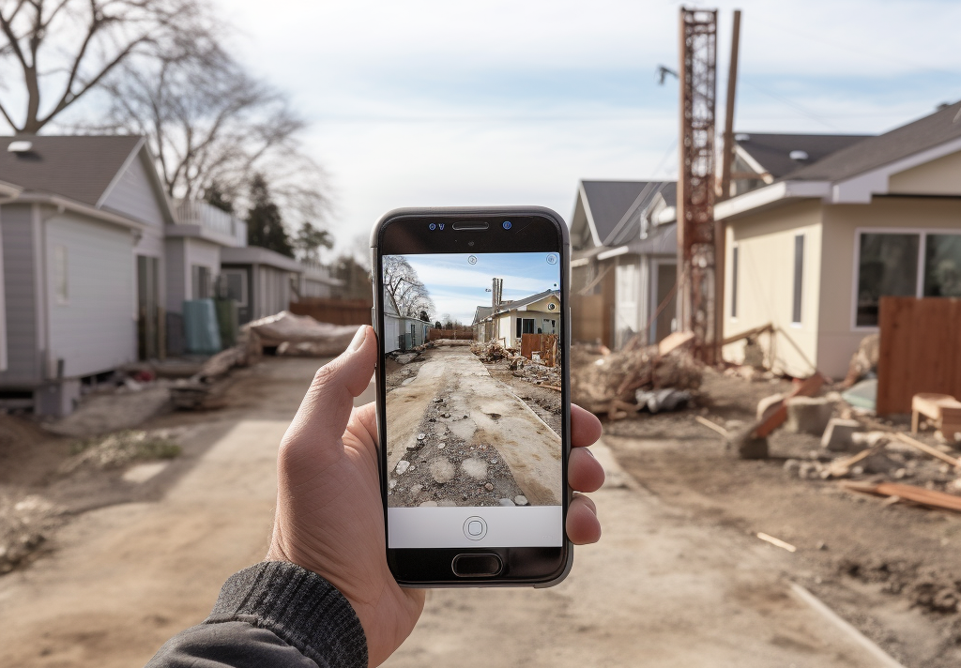
Site Selection
Consider Mission & Vision
Review Existing Target Areas
Understand Existing Community Plans
Meet with Neighborhood Residents and City Officials
Cost-Benefit Analysis
Be cautious of going right to the HUD $1 houses, foreclosures, or tax reversions.

Slide 14

Characteristics of Site
Character of the area (Residential/ Commercial/ Mix)
Character of the neighborhood (Crime, Housing Values, Schools, Amenities)
Marketability of the site or structure
Topography (If you can’t ride your bike across…don’t buy it)
Zoning & Land Use Compliance – Is the site properly zoned for the intended housing type and density?
Consistency with Surrounding Area – Does the project align with neighborhood scale, character, and existing uses?
Access to Transportation – Proximity to public transit, major roads, and walkability options/ Proximity to Amenities – Nearby schools, healthcare, grocery stores, and employment centers

Slide 15

Other Considerations of Site:
Utilities and infrastructure in close proximity – do they need to be updated (sewer, water, gas, electricity, roads, sidewalks, transportation, fire, communication, etc.)
Requirements for storm water management
Contributions to a healthy environment
Environmental concerns (lead, asbestos, underground tanks)
Soil conditions – previous use of the land (basement remnants, sand, clay, dead bodies)
Zoning and building codes
Other Compliance Issues (i.e. Historic)
Climate resilience

Slide 16

Why Site Control is Important:
Reasons for Site Control:
Allows time for planning and due diligence
Alleviates competition
Funders will require it
Protects your investment
Helps you make your best funding decisions
Types of Site Control:
Option
Purchase Agreement
Ownership

Slide 17
Option/ Purchase Agreement Considerations
Always allow for more time than you might reasonably need for due diligence.
Is the property insured?
Who will secure and maintain the property?
Access rights – Who, When, and How?
Deal breakers
Always use an attorney (not just any attorney, but a real estate attorney)
Are there existing tenants?

Slide 18

From Site Control to Success: What Else Matters?
Elected Officials
Tax Rebates or Pilots
Gap Funding
Public Support & Approvals
Gov. Agencies, MSHDA, HUD

Slide 19

Questions/ Comments
Using the past slides, identify challenges for site control and how to mitigate it.
What is one lesson about site control that will influence how you approach site selection in the future?

Slide 20
Future TA Date:
May 29, 2026 – Development and Operating Pro-Forma 10:30am

