Slide 1
Pro Forma Development
May 29, 2026

Slide 2

Types of Pro Formas
Development Pro forma
  Get it built
Operating Pro forma
  Keep it running
This Photo by Unknown Author is licensed under CC BY-SA

Slide 3
Development Pro Forma sources
Projection of all sources used to fund the project:
Owner Equity
+
Debt
+
Soft Loans/Grants
+
Deferred developer Fees
=
Total Project Sources

Slide 4
Development Pro Forma
Owner Equity –
usually 20-25%, actual cash, invested land, etc.
Debt – mortgage amount, calculations will be presented later
Soft Loans and Grants
Deferred developer fees – sometimes as much as 50%

Slide 5
Development Pro Forma uses
Projection of all costs related to the project:
Acquisition
+
Hard Costs
+
Soft Costs
+
Developer Fees
=
Total Project Costs

Slide 6
Development Pro Forma
Acquisition – cost to purchase land &/or buildings
Construction – Estimate per unit, peer square foot or actual estimate provided by contractor
Construction Contingency (Hard Costs) – Protect Developer (& partners, banks) from cost overruns. Usually 5% on new construction, 10% on rehab, 15% historic rehab
Soft Costs – Other costs incurred during the development process
Soft Costs Contingency – Usually 5% - MSHDA does not allow in their financing
Developer Fees –
usually 10-15%

Slide 7
Soft Cost Estimates
Architect & Engineering – Usually about 4 – 10% of the construction costs
Environmental Survey – Varies from $2,500 - $20,000 per site (depending if a NEPA is required – hire a good consultant)
Appraisal - $5,000 – 15,000 cost higher for commercial and mix-use projects
Survey - $1,500 - $5,000 per building or lot (depending if you need a topo & if its new construction)
Title Insurance - $3 per $1,000 insured value
Legal Fees - $5,000 - $90,000 depending on funding sources of the project

Slide 8
Soft Cost Estimates
Real Estate Taxes – Calculate by using the assessed value * tax rate * length of construction
PILOT – how does this impact calculation
Utilities - Calculate by assessment times length of construction or as flat fee for limited use
Insurance – Use quote from insurance carrier
Interest – Calculate by 50% of construction loan times the interest rate times length of the construction period
Lenders Fees – Use quote from lender
Marketing

Slide 9
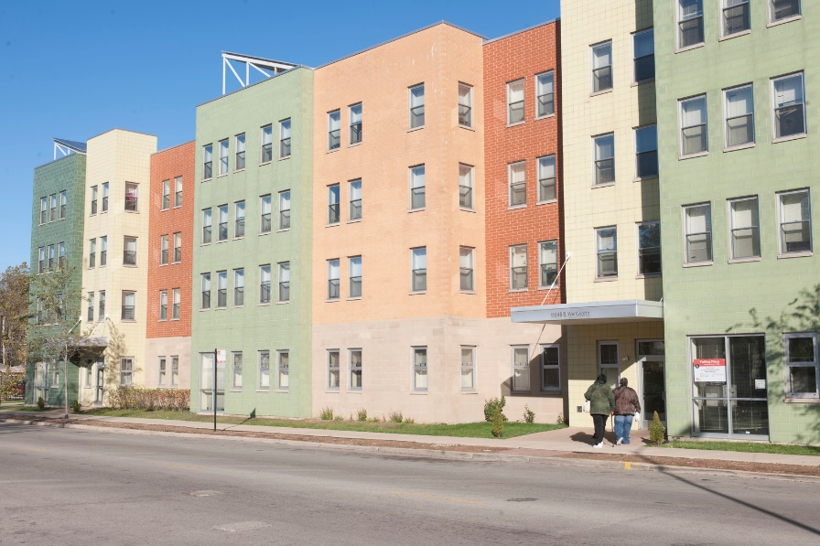
Development Costs
Most effective way to ensure costs are accurate is to bid the project for all line items
Three bids are generally acceptable

Slide 10
Operating Pro Forma
Gross Rental Income
Less: Vacancy (8-15% of Gross Income)
EQUALS
Effective Gross Income
Less: Expense
Operating Expenses
Management Fees
Taxes and Insurance
Utility Expenses
Accounting / Legal
Marketing
EQUALS
Net Operating Income (NOI)

Slide 11
Calculating Net Cash Flow
Net Operating Income
Less: Debt Service
Less: Reserves
EQUALS
Net Cash Flow

Slide 12
Calculating NOI Over the Loan Term
Pro-forma must show NOI over the life of the loan
After year 1, it is assumed that rents and expenses will rise given inflation
Standard Practice is to increase rents by 2% and expenses by 3%
MSHDA exceptions:
Prefers 1% rent increase for first 5 years and then 2%
Utilities often increase by 6% per year
Expenses should rise faster than gross rents to be conservative.

Slide 13

Vacancy
The percentage of rents a project will not receive because units are unoccupied
Also percentage of rents uncollected due to nonpayment by tenants
The percentage is higher during first year of operation, but then stabilizes
A standard 8-10% is used for most pro formas, depending on number of units. The smaller the # of units, the higher a % the lender will require

Slide 14

Calculation of Annual Expenses
Accounting
Property Management
Utilities
Maintenance
Advertising
Security
Trash Removal
Real Estate Taxes
Insurances
Other

Slide 15
Reserves
Operating Reserve is established to cover deficits that may occur during the operation of a project
Replacement Reserve is established to cover major repairs that will be necessary during the life of the project

Slide 16
Exercise #1 – OPERATING PROFORMA
Based on the Year 1 gross rents of $700 per unit (40 units) calculate the first year vacancy assuming a vacancy rate 8%. Put this amount in the first year operating Pro-Forma.
Assume the following Annual Operating Expenses
Accounting/Auditing & Legal $ 7,200
Property Management $26,680
Utilities $40,000
Maintenance $52,000
Administration $44,506
Property Taxes/PILOT $13,456
Insurance $30,000
Replacement Reserves $300/unit
Place these in the first year’s operating pro-forma

Slide 17
Exercise #1 – CASH FLOW
3) Based upon the income and expenses in the first-year pro forma calculate income and expenses over a five year period, assuming that rents will rise by 2% annually and expense will rise by 3% annually.

Slide 18
Exercise #1 Answers

Slide 19

Pause! Stand up and stretch!

Slide 20

Financial Ratios
Debt Coverage Ratio
Loan To Value
Break-Even Point

Slide 21
Financial Calculator
http://www.fncalculator.com/
Use TVM Calculator in the Finance and Investment section
Boot Camp Loan Calculator Excel

Slide 22
Debt Coverage Ratio (DCR)
DCR = NOI / Debt Service (Annual)
1:1 DCR means there is $1 of income for $1 of debt
DCR usually ranges from 1.10 to 1.30. The higher the DCR, the larger the cushion.

Slide 23
Purpose of DCR limit
The purpose of the debt coverage ratio is to limit the debt service, to insure that the debt service is less than the NOI by some comfortable margin.
DCR measures the projects ability to repay the debt.

Slide 24
Purpose of DCR limit
You can calculate the maximum loan amount by knowing the maximum DCR required by the lender.
Debt Service Max = NOI / DCR
Loan payment = Debt Service / 12
*constant = terms of the loan (7% and 30 years)

Slide 25
Exercise # 2
1) Using a loan amount of $1 million at 6% for 30 years, determine:
a) The annual debt service
b) The Debt Coverage Ratio in year 1 with NOI of $83,278
2) If the NOI is $83,278 and the DCR must be 1.15, what is the maximum loan size at 7% for 30 years?

Slide 26
Exercise # 2 Answers
Annual debt service
Debt coverage ratio - $83,278 / 71,946 = 1.16
Principal Amount | $1,000,000
Interest Rate | 6.00%
Term (years) | 30
Payment (annual debt service) | $ 71,946
Payment (monthly) | $ 5,996

Slide 27
Exercise # 2 Answers
Annual debt service
Debt coverage ratio - $83,278 / 72,416 = 1.15
Principal Amount | $907,052
Interest Rate | 7.00%
Term (years) | 30
Payment (annual debt service) | $ 72,416
Payment (monthly) | $ 6,035

Slide 28
Loan – to – Value Ratio
Measures the amount of value on a project to repay the loan in case of foreclosure
LTV = Loan Amount / Fair Market Value
Sometime FMV is determine by appraisal. Other time is determined by cost (Loan – to-Cost to LTC)

Slide 29
Maximum LTV
Industry standard usually like to see a maximum of 80% LTV.
  Property values decline in a weak market, where foreclosures are more likely
  While the property is being foreclosed upon and sold, real estate taxes and insurance are accruing, and have to be paid before the lender gets anything
  The cost of sale need to be paid out of the proceeds.

Slide 30
Exercise #4
If you have an appraisal of $120,000, and a loan amount of $75,000, what is the LTV?
If you have an appraisal of $130,000 and a maximum LTV of 80% what is the maximum loan amount?

Slide 31
Exercise #4 - Answers
LTV = $75,000 / $120,000 = 63%
Max Loan Amount = $130,000 * .8 = $104,000

